Slide 1
PROBLEMS

Slide 2
PROBLEMS
Discuss the difference between tightly coupled multiprocessors and loosely coupled multiprocessors from the viewpoint of hardware organization and programming techniques.
Tightly coupled multiprocessors require that all processed in the system have access to a common global memory.
Tightly coupled systems are easier to program since no special steps are required to make shared data available to two or more processors.
In loosely coupled multiprocessors, the memory is distributed and a mechanism is required to provide message-passing between the processors.
A loosely coupled system required that sharing of data be implemented by the messages (special software).
Based on M. Morris Mano “Computer System Architecture”--Assist. Lecturer Ahmed Salah Hameed

Slide 3
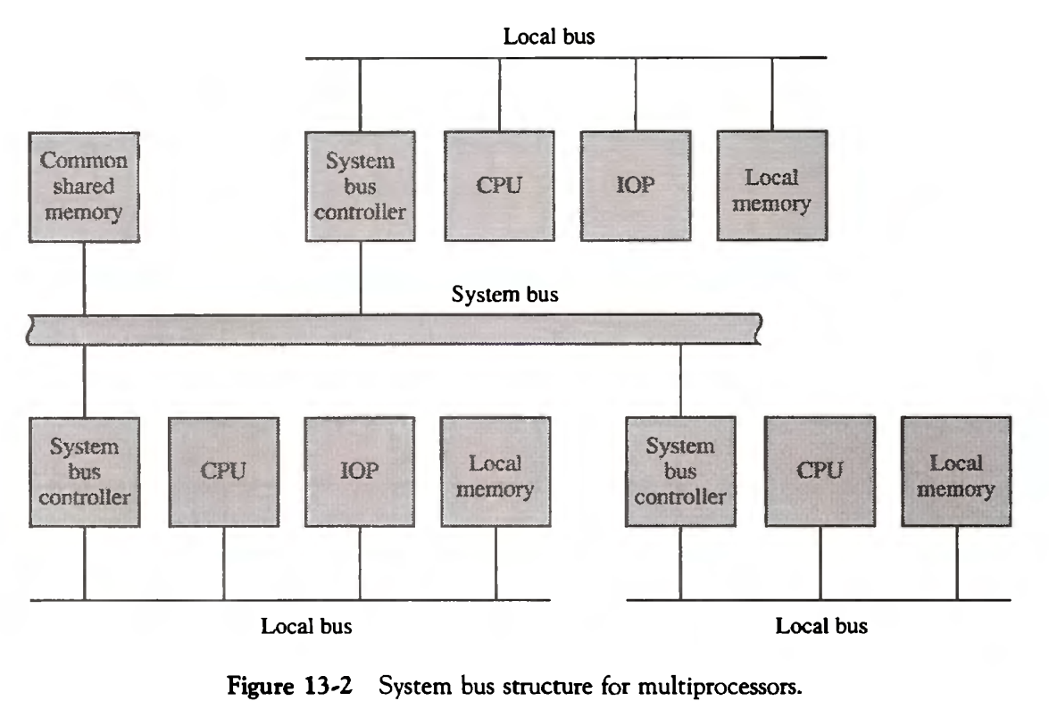
PROBLEMS
What is the purpose of the system bus controller shown in Fig. 13-2? Explain how the system can be designed to distinguish between references to local memory and references to common shared memory.
The address assigned to common memory is never assigned to any of the local memories. The common memory is recognized by its distinct address.
Based on M. Morris Mano “Computer System Architecture”--Assist. Lecturer Ahmed Salah Hameed

Slide 4
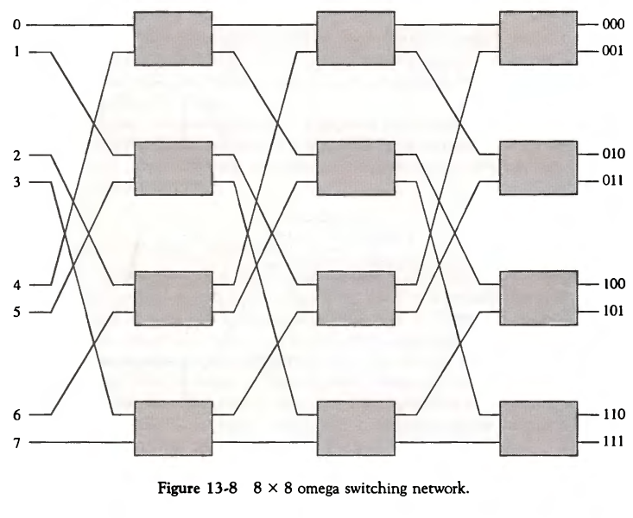
PROBLEMS
How many switch points are there in a crossbar switch network that connects p processors to m memory modules?
Switches = number of Processors × number of Memory modules
The 8x8 omega switching network of Fig. 13-8 has three stages with four switches in each stage, for a total of 12 switches. How many stages and switches per stage are needed in an n x n omega switching network?
Number of stages = Log of (n) for base 2
Number of switches per stage = n/2
Based on M. Morris Mano “Computer System Architecture”--Assist. Lecturer Ahmed Salah Hameed

Slide 5
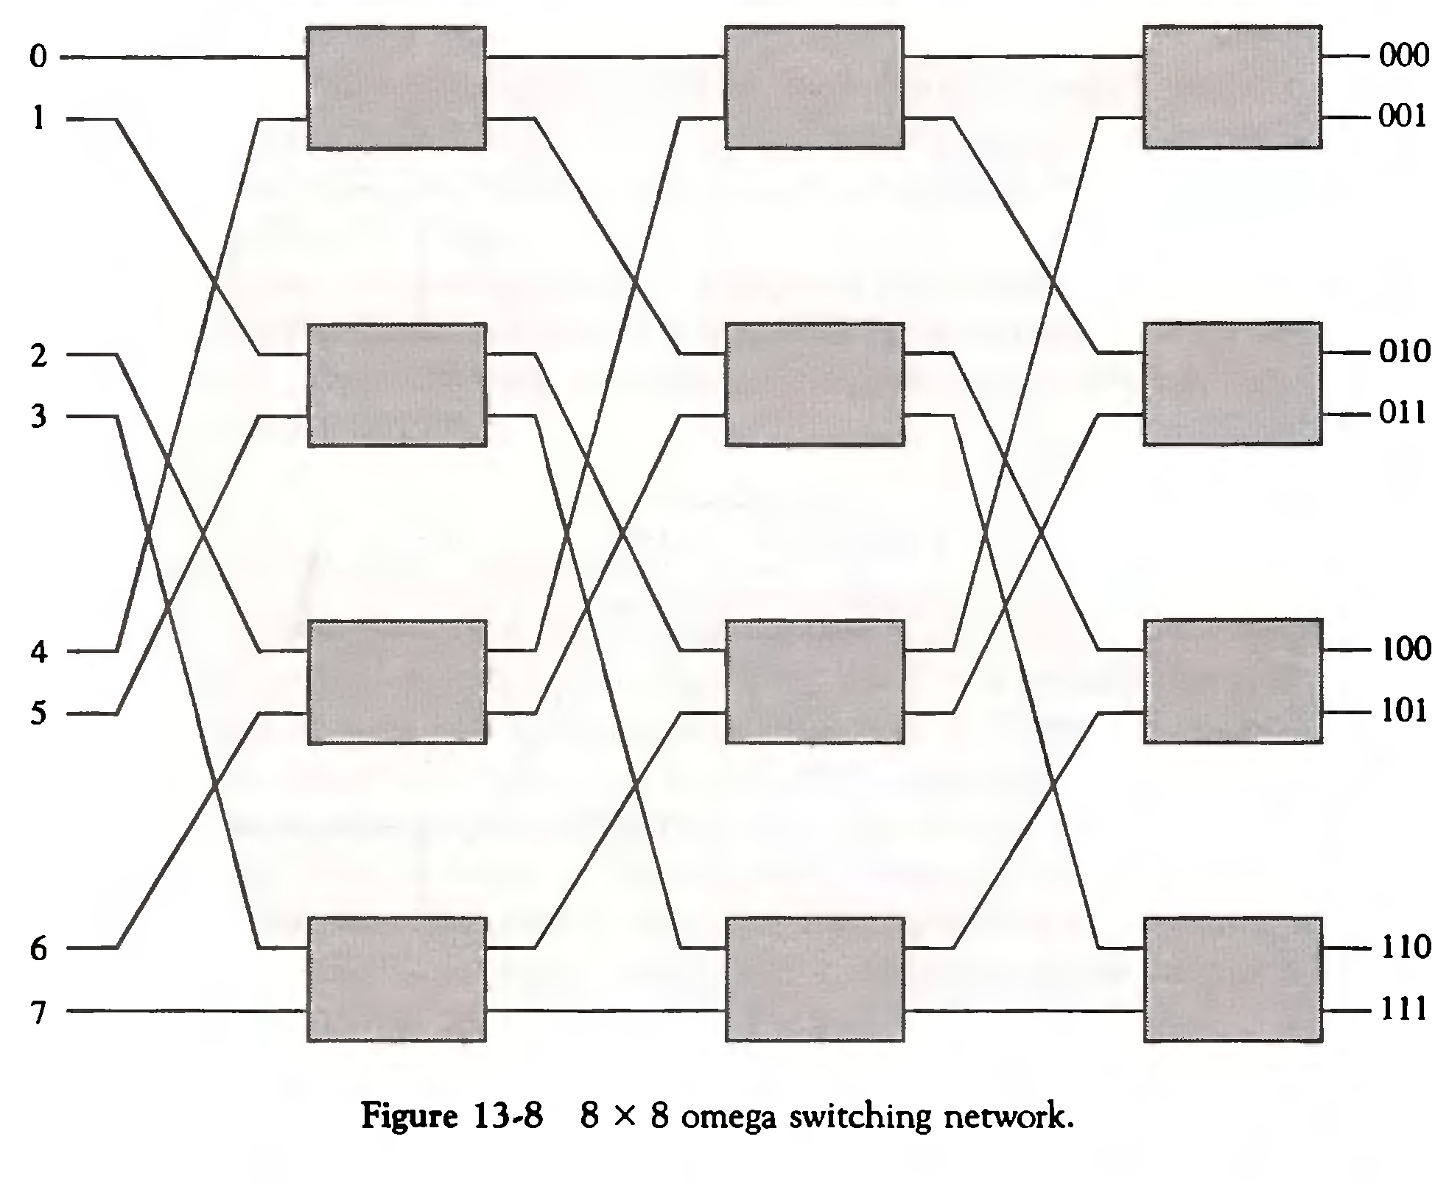
PROBLEMS
Suppose that the wire breaks between the switch in the first row, second column and the switch in the second row, third column in the omega switching network of Fig. 13-8. What paths will be disconnected?
Inputs 0, 2, 4, and 6 will be disconnected from outputs 2 and 3.
Based on M. Morris Mano “Computer System Architecture”--Assist. Lecturer Ahmed Salah Hameed

Slide 6
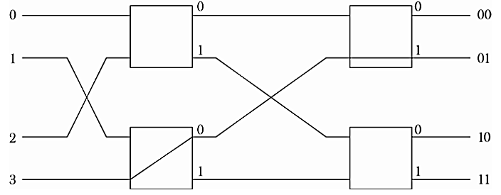
PROBLEMS
Construct a diagram for a 4 x 4 omega switching network. Show the switch setting required to connect input 3 to output 1.
Based on M. Morris Mano “Computer System Architecture”--Assist. Lecturer Ahmed Salah Hameed

Slide 7
PROBLEMS
Three types of switches are used to design a multistage interconnection network: an interchange switch with two inputs and two outputs as in Fig. 13-6, an arbitration switch with two inputs and one output, and a distribution switch with one input and two outputs.
Show how the arbitration and distribution switches operate.
b. Using arbitration and interchange switches, construct an 8 x 4 network with a unique path between any source and any destination.
c. Using distribution and interchange switches, construct a 4 x 8 network with a unique path between any source and any destination.
Based on M. Morris Mano “Computer System Architecture”--Assist. Lecturer Ahmed Salah Hameed

Slide 8
PROBLEMS
Based on M. Morris Mano “Computer System Architecture”--Assist. Lecturer Ahmed Salah Hameed

Slide 9
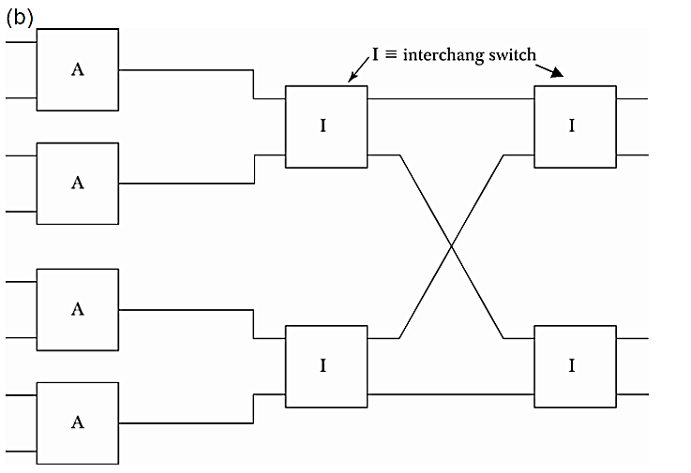
PROBLEMS
Based on M. Morris Mano “Computer System Architecture”--Assist. Lecturer Ahmed Salah Hameed

Slide 10
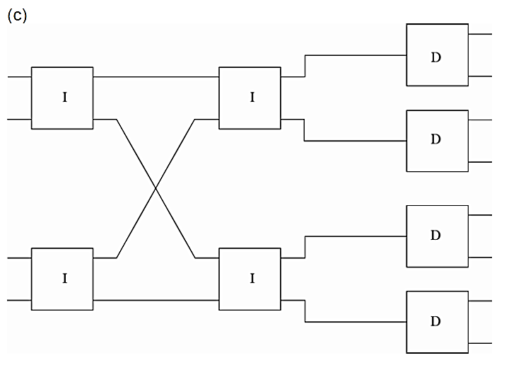
PROBLEMS
Based on M. Morris Mano “Computer System Architecture”--Assist. Lecturer Ahmed Salah Hameed

Slide 11
PROBLEMS
Draw a diagram showing the structure of a four-dimensional hypercube network. List all the paths available from node 7 to node 9 that use the minimum number of intermediate nodes.
Based on M. Morris Mano “Computer System Architecture”--Assist. Lecturer Ahmed Salah Hameed

